Slide 1

AI-Based Phishing Detection & Response Agent
SOA Project Review-2
 | Under the Guidance of Dr.Neelima Gogineni Proffessor Department of Computer Science and Engineering, KLH CSE Bowrampet Campus
Team Members A.Lahari – 2420030055 P.Priyanka – 2420030132 P.Sreehitha-2420030410

Slide 2
Outline of Project Work
Focus
Introduction
Literature Survey
Challenges
Research Objectives
Conclusion & Future Work
References
Publications Details

Slide 3
Problem Statement
Existing phishing detection systems mainly rely on predefined rules, blacklists, and manually engineered features. These approaches may fail to detect newly generated or evolving phishing attacks. There is a need for an intelligent system that can automatically analyze suspicious URLs, emails, and messages, identify phishing attempts, and recommend or initiate an appropriate response. Existing solutions mainly concentrate on detecting and classifying phishing attempts, but they may provide limited support for deciding what action should be taken after a threat is detected. There is therefore a need for an intelligent system that can analyze suspicious content, identify phishing patterns, assess the level of risk, and assist in taking an appropriate response.

Slide 4
Objectives
Develop an AI-based system for detecting phishing attacks.
Analyse URLs, email content, and suspicious messages.
Extract relevant features from the input data.
Train a machine learning/deep learning model to classify legitimate and phishing samples.
Provide a risk score for detected threats.
Generate an automated response or recommendation for the user.
Reduce false positives and improve phishing detection accuracy.

Slide 5
Literature Survey
Authors | Title of the Paper | Methodology | Inferences | Limitation/Future work
Haq et al. | Detecting Phishing URLs Based on a Deep Learning Approach... | Deep Learning, URL features, classification | AI can effectively detect phishing URLs | Mainly URL-focused; can be extended to emails/messages
Rashid et al. | Phishing URL Detection Generalisation Using Unsupervised Domain Adaptation | ML/DL, Domain Adaptation | Addresses poor generalization to new data | Can be extended beyond URL-based detection
R. Gobinath & S. Manikandan | Deep learning-based phishing classification framework for accurate detection using optimized URL intelligence | Deep Learning + optimized URL features | Addresses limitations of rule-based and blacklist-based systems and targets dynamic phishing URLs | Further improvement is needed for zero-day/camouflaged attacks

Slide 6
Problem Gap Identification
The major gap is that many existing solutions focus mainly on detection, while fewer systems provide an integrated detection + intelligent response mechanism.
Your project addresses this gap by combining:
Phishing Detection → Risk Analysis → AI Decision → Automated Response

Slide 7
Innovation, Creativity, and Novelty
1. AI-Based Phishing Detection
Uses AI/ML techniques to identify phishing attempts instead of relying only on predefined rules or blacklists.
2. Multi-Level Analysis
Analyses different phishing indicators such as URLs, email/message content, and suspicious patterns to make the detection more reliable.
3. Risk-Based Decision Making
Instead of giving only “Phishing” or “Legitimate”, the system generates a risk score indicating the severity of the detected threat.
4. Detection + Response in One Agent
The project combines phishing detection, risk assessment, and response assistance into a single intelligent agent.
5. Automated Response Assistance
After detecting a threat, the agent can recommend actions such as Alert, Block, or Report, reducing the need for manual decision-making.

Slide 8
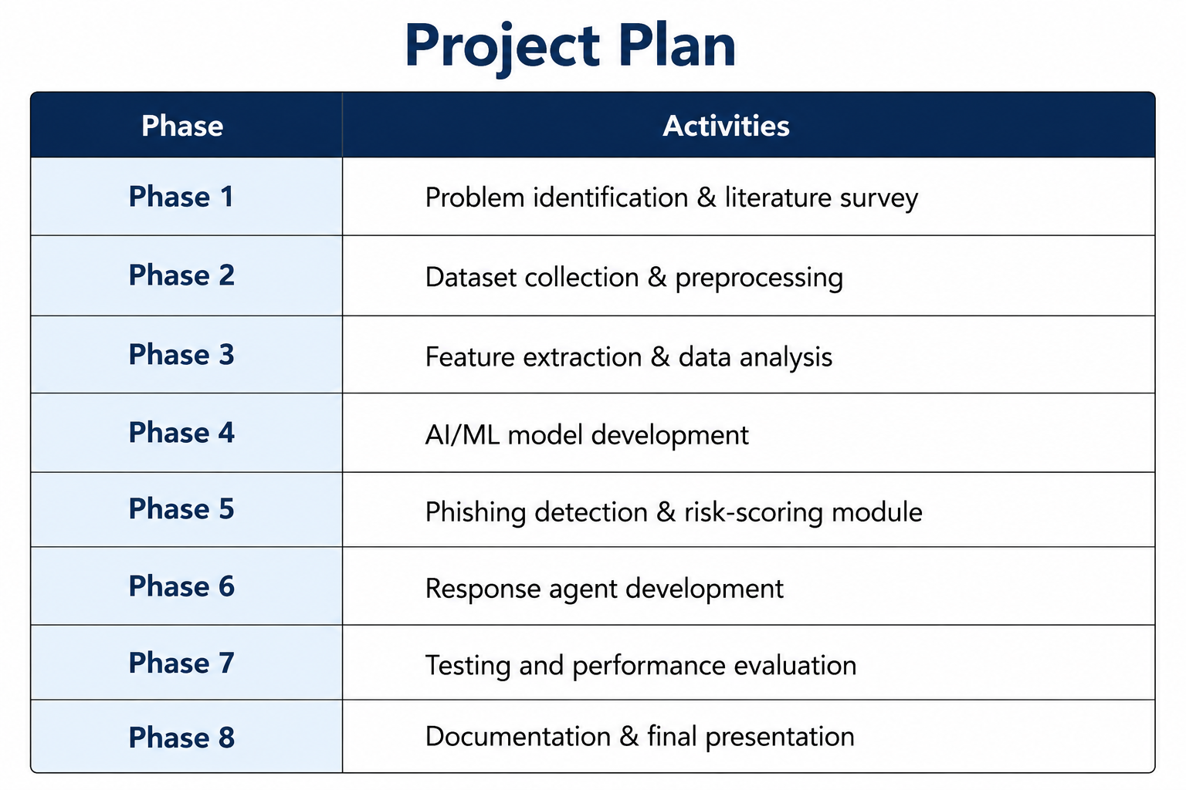
Feasibility and Project Plan
The proposed project is technically feasible using open-source technologies such as Python, Scikit-learn, Flask, React.js, and MongoDB. Publicly available phishing datasets can be used for training and testing the AI/ML model, and the system can run on a standard computer without specialized hardware. Therefore, the project is cost-effective, practical, and feasible for implementation.

Slide 9
Project Design
Input: URL / Email Content
Detection Service → extracts features and predicts phishing likelihood
Risk Service → calculates risk score and threat level
Response Service → Allow / Warn / Block / Report

Slide 10
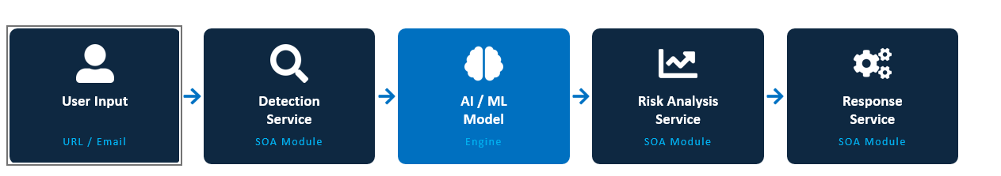
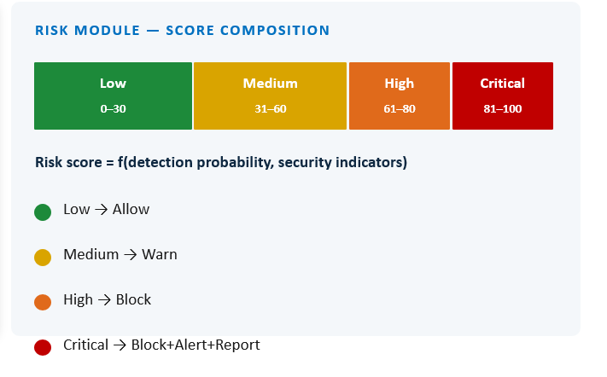
System Architecture

Slide 11
Methodology Adopted
1. Input Collection – URL or email/message content
2. Feature Extraction – URL length, special characters, IP usage, HTTPS, suspicious keywords, etc.
3. ML Detection – classify input as legitimate or potentially phishing
4. Risk Assessment – generate risk score and level
5. Response Decision – select an appropriate action
6. Evaluation – accuracy, precision, recall, F1-score and confusion matrix

Slide 12
AI/ML Detection
Features are extracted from suspicious inputs and converted into numerical values.
A classification model such as Random Forest, Decision Tree, or Logistic Regression can be trained.
Example output: Phishing probability / prediction.
The final model and performance values should be based on the actual trained dataset.
Risk Analysis
The risk service combines the detection result with security indicators.
Example risk levels:
• 0–30: Low
• 31–60: Medium
• 61–80: High
• 81–100: Critical

Slide 13
Technical Soundness
Python – core development
Pandas / NumPy – data processing
Scikit-learn – machine learning
Flask / FastAPI – REST APIs
HTML / CSS / JavaScript – user interface
MongoDB / SQLite – optional data storage
Modular services make the system easier to test, maintain and extend.

Slide 14
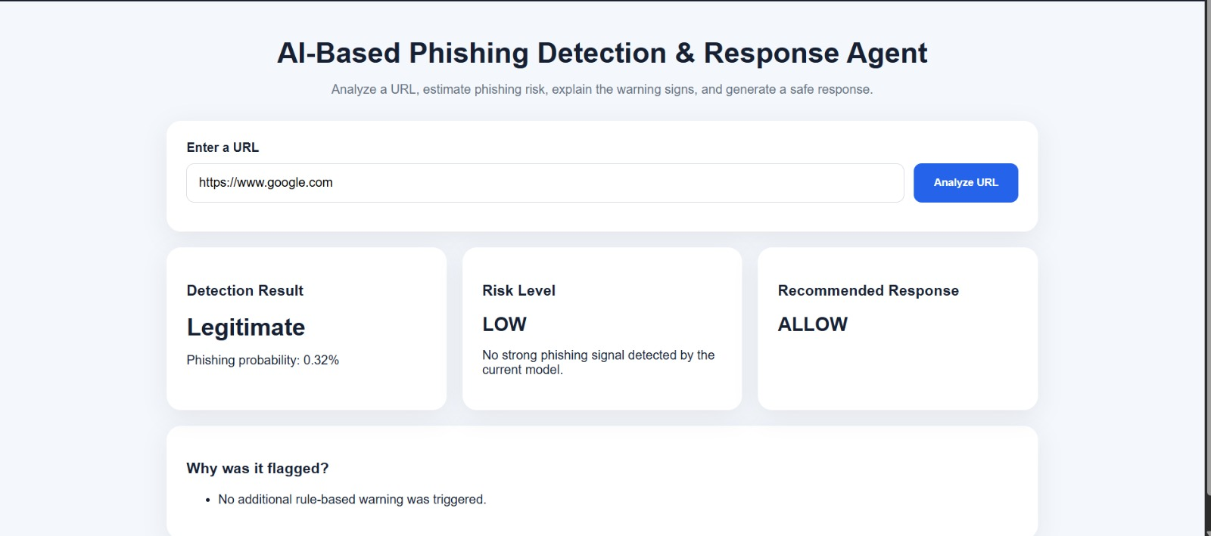
Sample Output

